Slide 1
Week 2, Classes 3-4 Advanced LP
Keto Diet
Analyzing Linear Programs
Piecewise Linear Programs
Burrito Game!
Homework Notes

Slide 2

More on the Diet Problem
https://mat.tepper.cmu.edu/blog/index.php/2010/11/21/keto-diets-and-linear-programming/

Slide 3
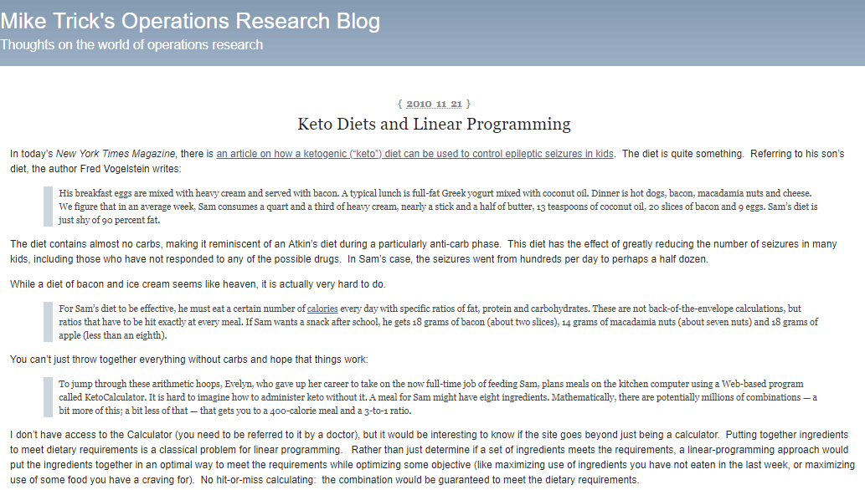

Slide 4
https://mat.tepper.cmu.edu/blog/index.php/2010/11/21/keto-diets-and-linear-programming/

Slide 7
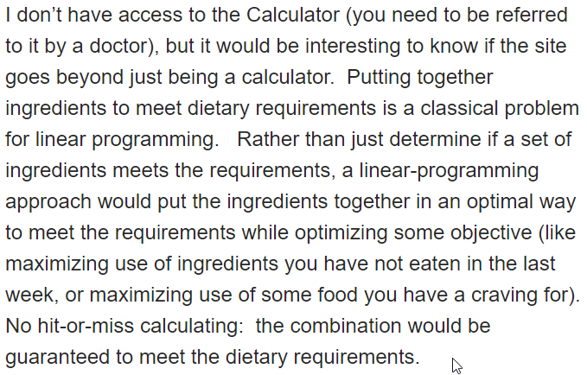

Slide 8
Analyzing Linear Programs

Slide 9



Analyzing Linear Programs
What-if Analysis
Changing parameters and re-running
Just look at the results
Tight constraints– show you where the model would like to add capacity, add raw materials, sell more, etc…
Constraints that aren’t tight– tell you where there is slack
More technical (Mike has a hot take on this one):
Shadow prices– can give you the “value” of changing the constraint
Analysis comes from looking at Primal and Dual LP’s (save this thought for a second)
Sources: Robert Sedgewick and Kevin Wayne, Intro slides from Vladlen Koltun.
The Allocation of Resources by Linear Programming. Scientific American, R. Bland

Slide 10



Let’s Look at Sensitivity Analysis
Increase the availability of Corn to 481. What happens?
Hops to 161…
Malt to 1191
Increase the availability of Corn to 580 (+100), then to 680 (+200). What happens?

Slide 11
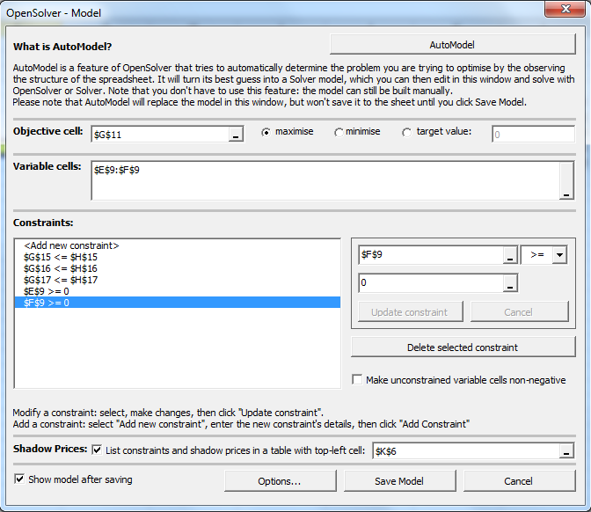
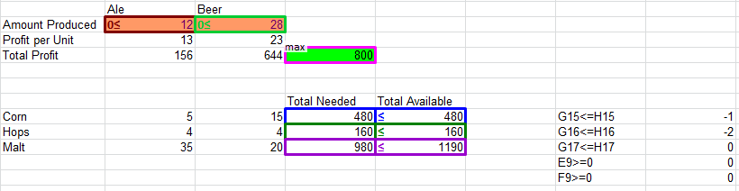
Let’s See How Those Numbers Relate to Shadow Prices

Slide 12
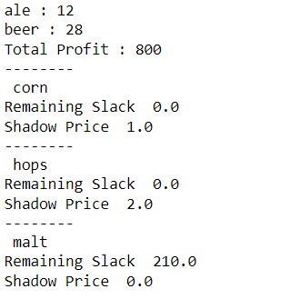

Let’s See How Those Numbers Relate to Shadow Prices

Slide 13
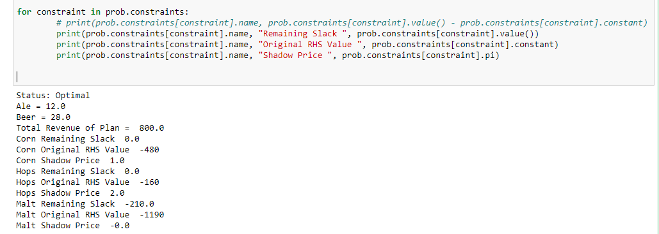
Let’s See How Those Numbers Relate to Shadow Prices

Slide 14
Sensitivity Analysis for the Brewer’s Problem
How much should the brewer be willing to pay (marginal price) for additional supplies of scarce resources?
Corn ?
Hops?
Malt?
How do these prices relate to the shadow prices?
New product “light beer” is proposed. It requires 2 corn, 5 hops, and 24 malt. How much profit must be obtained from light beer to divert raw materials from beer and ale?
Answer: 2 x $1 + 5 x $2 + 12 x $0 = $12
Sources: Robert Sedgewick and Kevin Wayne, Intro slides from Vladlen Koltun.
The Allocation of Resources by Linear Programming. Scientific American, R. Bland

Slide 15
Let’s See How Those Numbers Relate to Shadow Prices
Where do these Slack Values Come From?

Slide 16
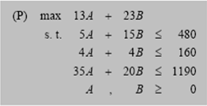
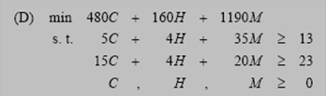
Dual Problems
Think of the original Linear Program as the Primal
Every Linear Program has a Dual
In rough terms, the dual problem is the reverse of the Primal
The constraints become decision variables, the decision variables become constraints
C
H
A
M
B

Slide 17
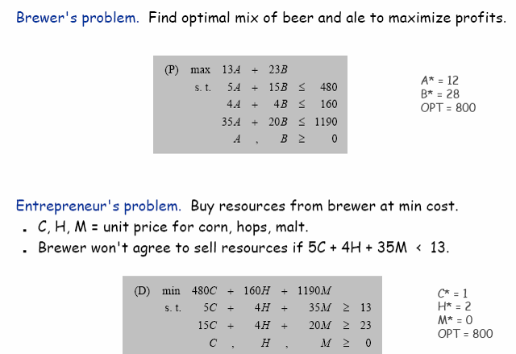
Duality for the Brewer’s Problem
Sources: Robert Sedgewick and Kevin Wayne, Intro slides from Vladlen Koltun.
The Allocation of Resources by Linear Programming. Scientific American, R. Bland

Slide 18
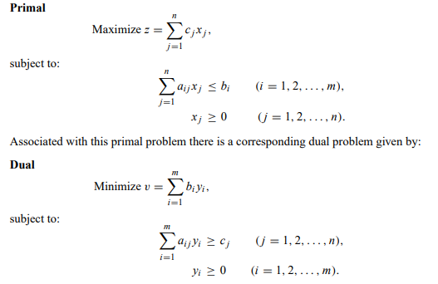
Primal-Dual– More General Overview
Let’s see what the code looks like…
http://web.mit.edu/15.053/www/AMP-Chapter-04.pdf

Slide 19

Some Equivalents….
Primal Optimal Objective = Dual Optimal Objective
Min X = Max -X
Max X = Min -X
We point this out because different solvers may have defaults- like they turn everything to a Min or Max

Slide 20
Shadow Prices
Work for Linear Programs (not Integer and most models are integer)
Provide information on the impact to the objective value of small changes to the constraint (or right-hand side)
Correspond to tight constraints
Can provide value on the relative value of relaxing tight constraints
Does not necessarily
Provide information on multiple changes at once
Provide information on large changes

Slide 21
My Hot Take Comments on Dual/Primal and Shadow Prices
If you know about Linear Programming, you should probably know about Shadow Prices and Dual Problems
The shadow prices can be useful sometimes
Sometimes (~5% of the time) the dual problem has a more intuitive interpretation
Some sophisticated algorithms take advantage of dual problems- you should know they exist and what they mean
I’m not sure I should even teach it in this class
Every other professor covers it
Shadow prices are only for small changes and…
Only work for linear programs (and most problems have integer variables)
They were a lot more useful when computing power was at a premium and linear programs ran slow (remember, since 1988 LP’s are more than 5 million times faster!!)
People are finding that is easier to just run a variety of what-if scenarios or programmatically get insights

Slide 22
Piecewise LPs

Slide 23
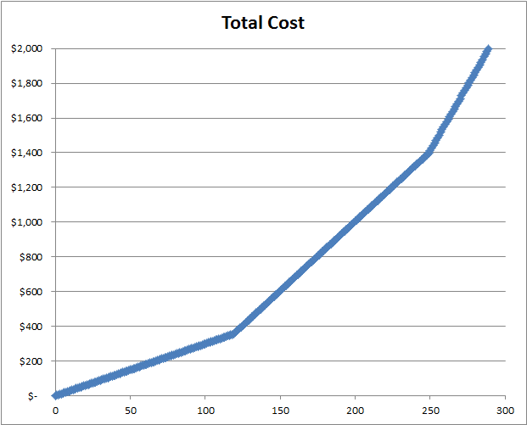
Linear Programming is Great… How to Get the Most from Linear…
Linear formulations can be good approximations
You can formulate piece-wise linear programs
To capture some aspects of the problem that follow this type of cost structure
To approximate a curve

Slide 24
Let’s Practice with a Very Simple Example
Company buys slabs of raw steel, does minor processing and resells the slabs
They can sell for $5.50 per slab
They have a budget of $3,000 to buy slabs
They can buy slabs at the following prices
Build a simple LP and solve to maximize profit
Number of Slabs | Problem #1: Cost per Slab | Problem #2: Cost per Slab
Up to 120 | $3 | $5
121 to 250 | $4 | $4
251 and above | $5 | $3

Slide 25
Piecewise Linear Programs
Can be helpful and make LP’s more realistic
Show the power of LP’s to capture reality
Shows the importance of being able to model
Must be used with caution:
The piecewise linear curve must naturally match with the problem so that it naturally uses the lower breakpoints first
In LP, there is no way to force it to use higher-cost items first (Integer Programming can fix this)
A lot more powerful when combined with Integer Programming

Slide 26
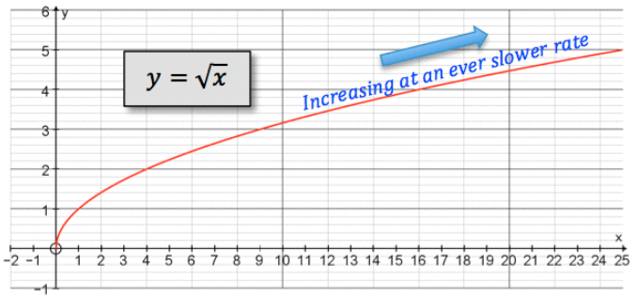
Piecewise Linear Programs
Trade-off between number of breakpoints, where they are, and fit of the line

Slide 27
Piecewise Linear Programs
One Segment
Trade-off between number of breakpoints, where they are, and fit of the line

Slide 28
Piecewise Linear Programs
Two Segments
Trade-off between number of breakpoints, where they are, and fit of the line

Slide 29
Piecewise Linear Programs
Three Segments
Trade-off between number of breakpoints, where they are, and fit of the line

Slide 30
Piecewise Linear Programs
Four Segments
Trade-off between number of breakpoints, where they are, and fit of the line

Slide 31
Piecewise Equations- Automatic or with 0-1 Variables
Max: concave obj fun
Min: convex obj fun
LP will
automatically
select lower
segment first
Max: convex obj fun
Min: concave obj fun
need 0-1 integer
variables to force
LP to choose
allowable segments

Slide 32
Warm Up for Next Week

Slide 33


Slide 34
Homework– More Modeling Practice

Slide 35
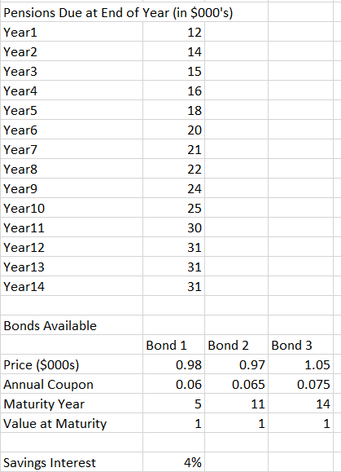
Flow Model—Time periods are more directly linked
Need to invest to cover the pensions due at the end of the year
Start the model at the start of Year 1 (or Year 0, if you’d like)
You can buy the 3 bonds or invest in savings
Flow In: Initial investment
Flow Out: Investment in the bonds and savings
At Year X
Flow In: coupons, interest, principal
Flow Out: pension payment, reinvestment in savings
Can’t buy the bonds after the start

Slide 36
Note on the Homework Problem #3
In this problem, I’m asking you to build an LP that you will give to the VP of sales. The VP of sales must be able to use the tool– you don’t want him or her to keep bugging you…
Not a GUI exercise. Assume that there is a nice GUI and the VP can play with the variables you want them to play with and hit run (you don’t need to build this part).

Slide 37
End of Section

